Slide 1

Cellula
Task 5
GROUP 1
Page 1

Slide 2
"Fare Prediction Model
for Airport Transfers
Page 2

Slide 3


Objective
predict taxi fare prices for airport transfers
Try different models and choose the best one
Page 3

Slide 4
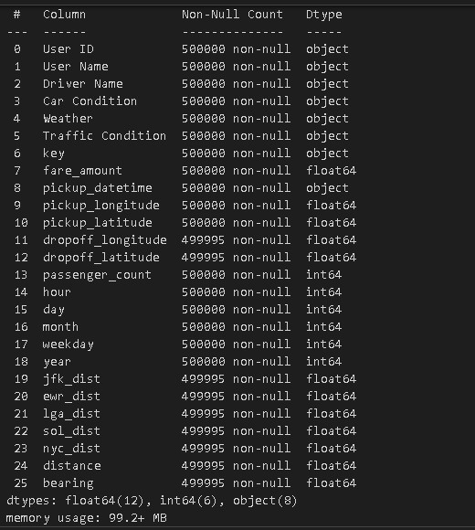
Dataset Overview
Consists of ( rows:50000, columns:26 )
data set doesnot any duplicate values
Null values are replaced with 0
data info ( data types of each column) :
Page 4

Slide 5
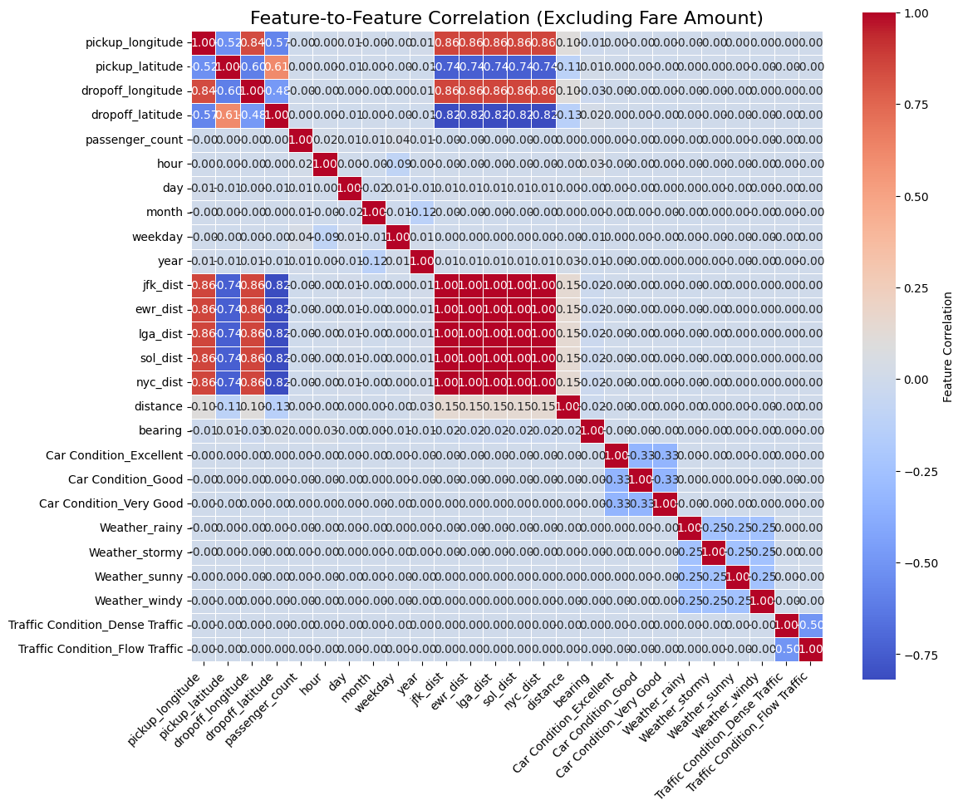
Data Preproccessing
Removed irrelevant columns(User Name,Driver Name,key, pickup_datetime,etc..)
Encoding using label encoding for columns(User_ID, Weather, Traffic Conditions, Car condition)
Visualizing the data in order to select best features
Page 5

Slide 6
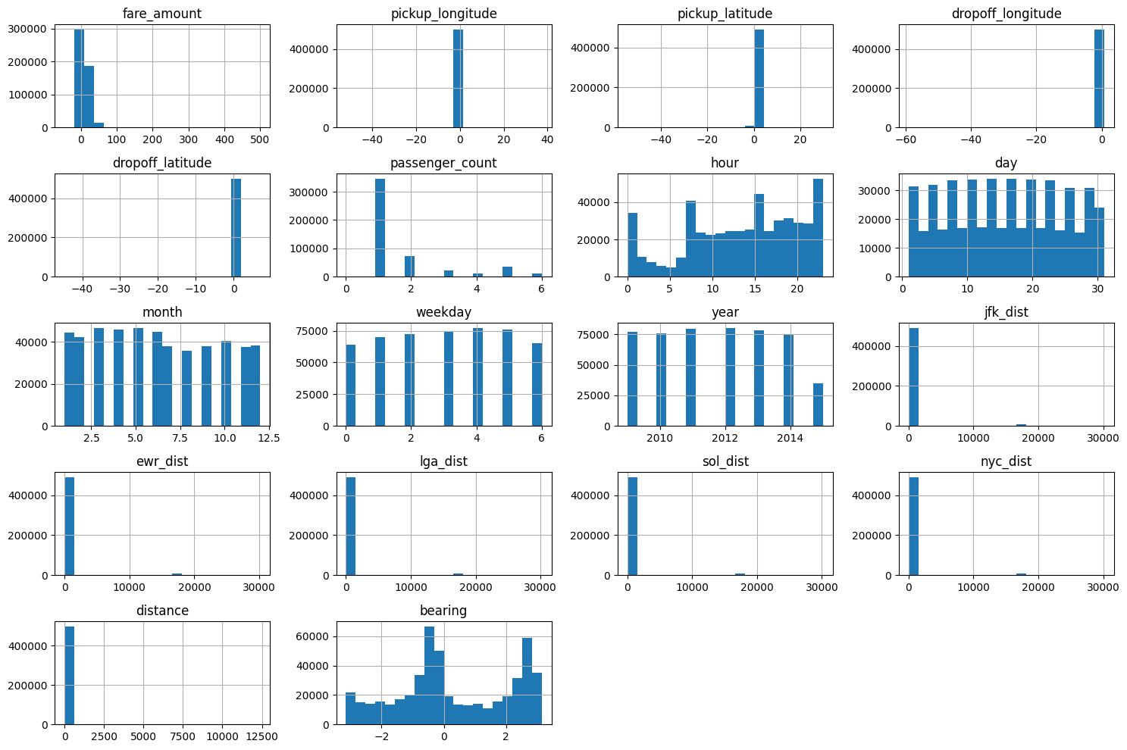
Data Insights
Page 6

Slide 7
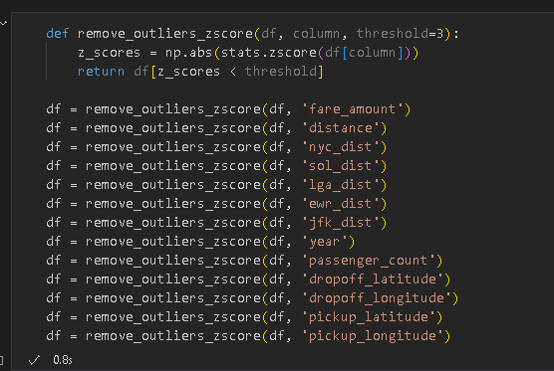
Outliers removal
Removing the unnecessary data that might interfere with the model training/testing
fare amount
distance
time
latitude/longitude
passenger count
Page 7

Slide 8
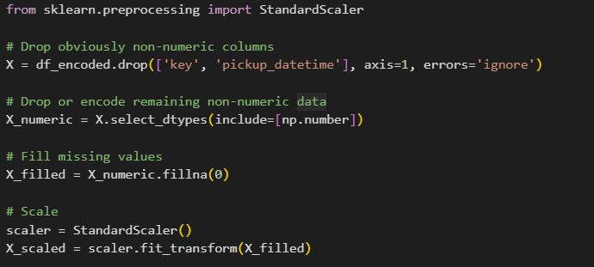
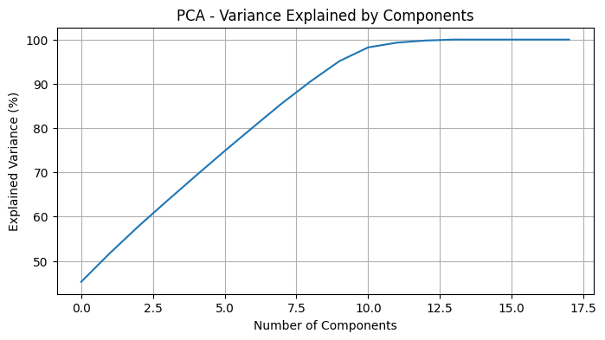
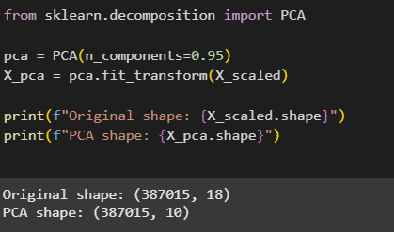
Dimension Reduction
after applying PCA to reduce the dimesions
using varience 95%
original dimensions were 18 and after Pca became 10
Page 8

Slide 9
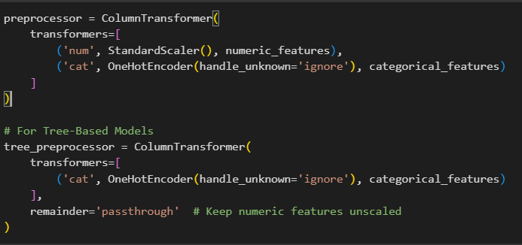
Feature scaling
preparing Features for different models
for linear Models Scaled the numerical data and encoded the categorical
for Tree models encoded the categorical data as it is not affected with scaling
Page 9

Slide 10
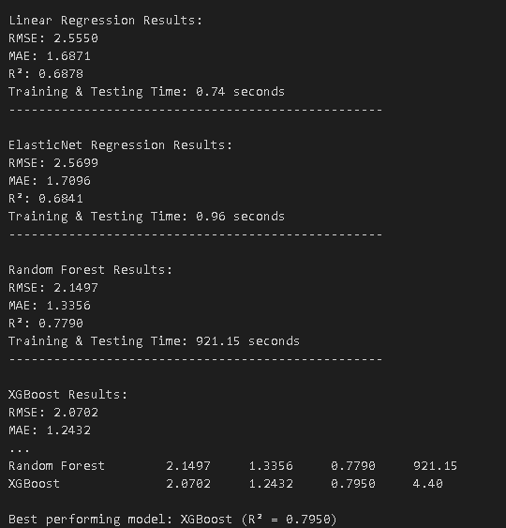
Model Training
after splitting the data into Y and X we have to train our models which were
Linear Regression
Elastic_Net (Ridge and Lasso together)
Random Forest
XGBoost
With Xgboost scoring the highest accuracy 79%
Page 10

Slide 11
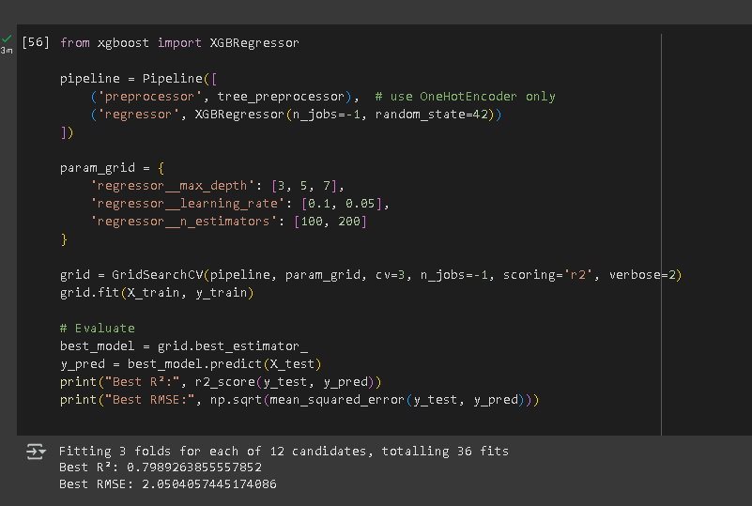
Finetuning
Finetuning the best model in order to achieve the best result possible
Page 11

Slide 12
Thank You
FOR YOUR ATTENTION
Page 12

